Slide 1

Marketing

Slide 2

Executive Summary
Objective: This report highlights key strategies to improve profitability while maintaining customer engagement at Prism
Key takeaways
10% off and 15% off coupons are more profitable out of all the coupon types as they bring in the highest transaction revenue and net profit. We recommend removing 10% discount coupons, and instead introducing a threshold of £30 to be eligible for 15% off coupons which could potentially generate £15000.
Google has sustained strong performance throughout, characterized by notable improvements in Return on Ad Spend (ROAS), number of customers, revenue and coupon usage.
To capitalize on this upward trend, our proposal entails the initiation of a targeted Google Ads initiative. Based on Prism’s current conversion rate (0.58%), the net profit could increase by £1M.
Google landing page optimization could potentially bring in £18K net profit.
Notes:
Aim - Telling Stories
Objective - holistic view of the potential opportunities to improve profit for Prism.

Slide 3
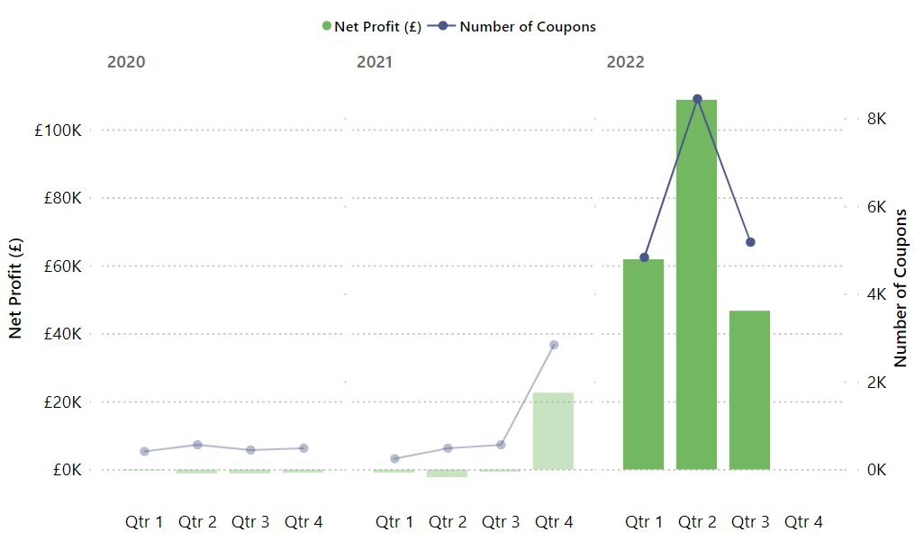
Coupon Power Surge: Driving Net Profit Growth
Notes:
Ecommerce Customer Retention Marketing: How to Use Emails, Loyalty Programs & Communities to Improve Retention (2024) - Shopify UK

Slide 4
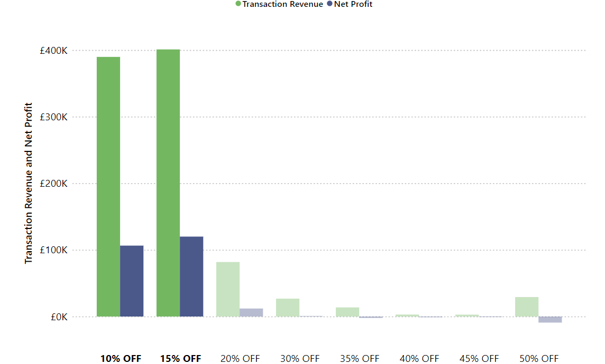
Coupon Gold: Unveiling the Profitable Power of 10% and 15% Off Offers
Notes:
10% off coupons and 15% off coupons had highest transaction revenue and net profit
Investing more in these coupons instead of the higher discount coupons could potentially be more profitable

Slide 5
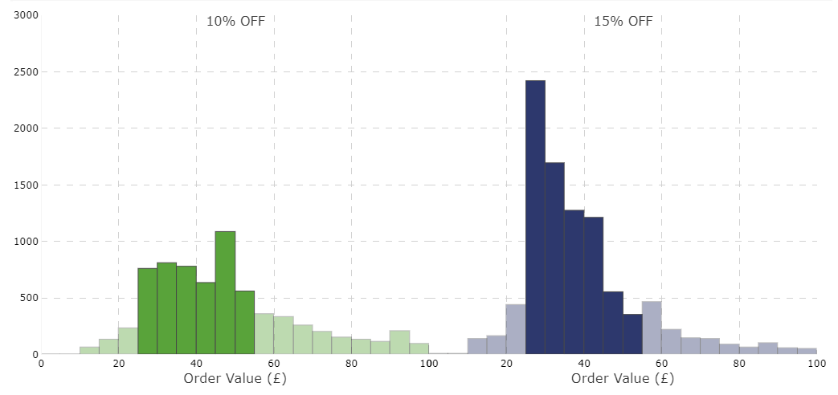
Coupon Craze: Targeting Orders £25-£55
Recommendations: As lower value coupons are desirable we recommend scraping 10% coupons and keeping 15% coupons with £30 order value threshold
Financial impact: Adding a threshold of £30 for coupon usage, 15% coupons could potentially bring in £15000, (10% coupons would only bring in an additional ~£3000). With removing 10% coupons completely we could recoup £43000.
Notes:
Opportunity 1: Coupon
Insight: 10% off and 15% off coupons appear to be more profitable out of all the coupon types, in terms of profit and number of coupon usage.
Financial impact: Adding a threshold of £30 for coupon usage, 15% coupons could potentially bring in £15000, (10% coupons would only bring in additional ~£3000). With removing 10% coupons completely we could recoup £43000.
Recommendations: As lower value coupons are desirable we recommend scraping 10% coupons and keeping 15% coupons with £30 order value threshold

Slide 6
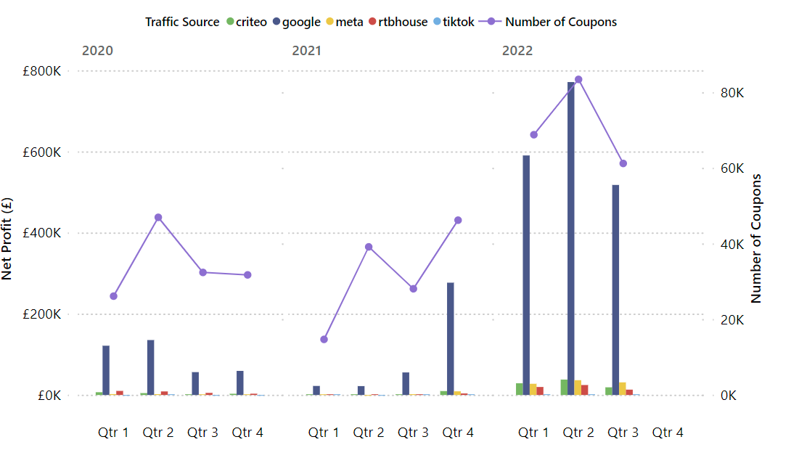
Google Traffic Source Leads the Pack in Coupon Usage
Notes:
Transition from coupons to Google as profitable channel…
Google’s Net Profit is highest across all channels,

Slide 7
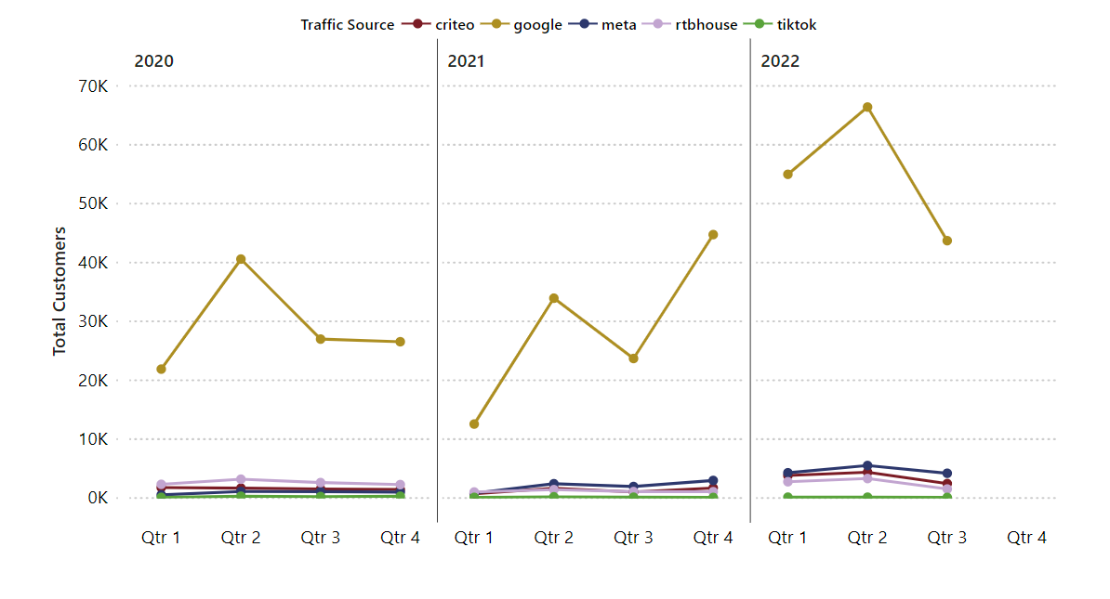
Google Dominates Customer Base: Leading Traffic Source for Prism
Notes:
Google - performing better than all other channels in terms of CVR, number of customers, revenue etc…. How can we ensure that the profit and profit margins are increased …
Looking at the coupons applied on Google, the items bought, AVB - customer groups?
Then recommendations - altering basket value threshold for applying coupons
Coupons on certain items - higher value, rather than low value items
Product bundles on most popular items with highest profit…
ROI on recommendations

Slide 8
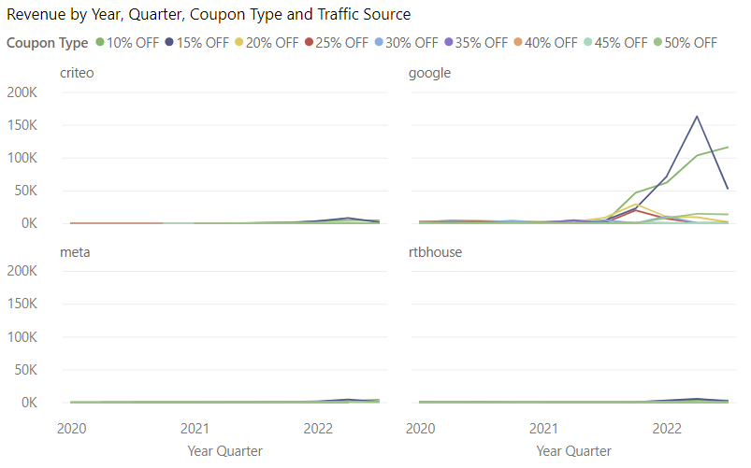
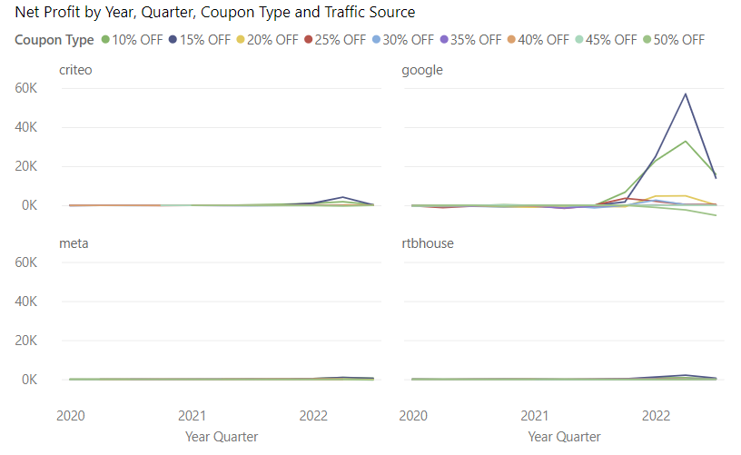
Decoding the Coupon Impact: Revenue and Profit Analysis Across Traffic Sources

Slide 9
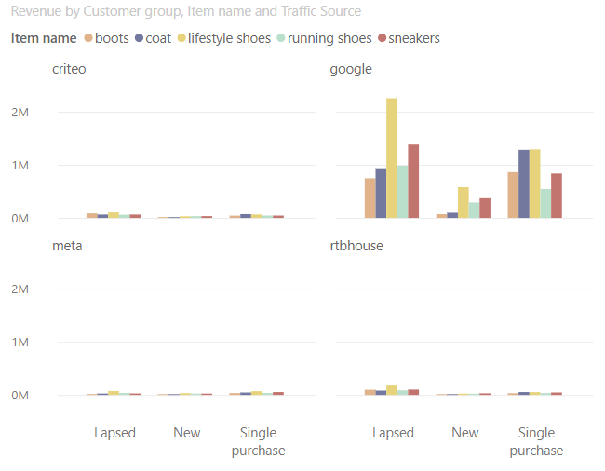
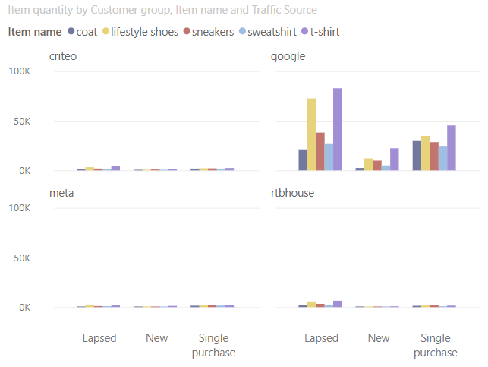
T-Shirts Reign in Popularity, Lifestyle Shoes Step Up Revenue
Recommendation: We recommend Landing Page Optimization based on our item popularity
Financial impact: by using Keyword Optimization, the net profit could increase by over £1M
Notes:
We can look for the appropriate keyword to optimize based on

Slide 10
Conclusions
Key takeaways
10% off and 15% off coupons are more profitable out of all the coupon types as they bring in the highest transaction revenue and net profit. Based on this, we recommend keeping the 10% off and 15% off coupons. Adding a threshold of £30 for coupon usage, 15% coupons could potentially bring in £15000, (10% coupons would only bring in an additional ~£3000). With removing 10% coupons completely we could recoup £43000.
Google has exhibited sustained strong performance throughout, characterized by notable improvements in Return on Ad Spend (ROAS), number of customers, revenue and coupon usage.
To capitalize on this upward trend, our proposal entails the initiation of a targeted Google Ads initiative. Based on Prism’s current conversion rate (0.58%), the net profit could increase by £1M.
Google landing page optimization could potentially bring in £18K net profit.
Notes:
Aim - Telling Stories
Objective - holistic view of the potential opportunities to improve profit for Prism.

Slide 11
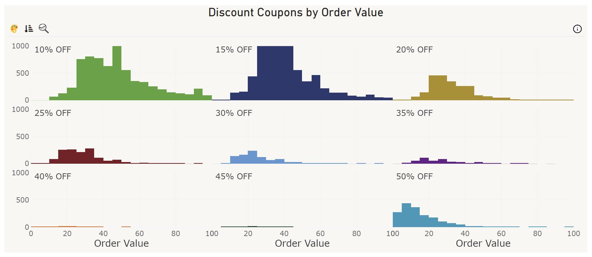
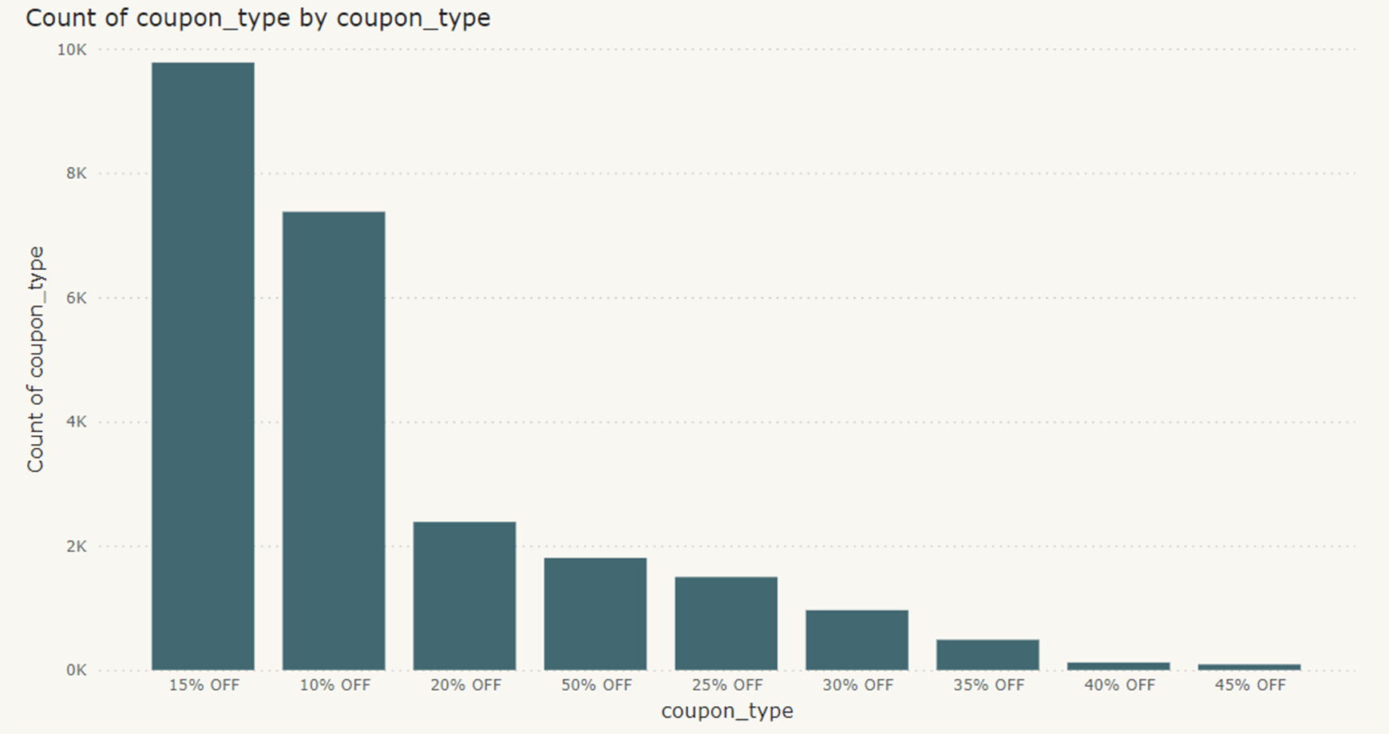
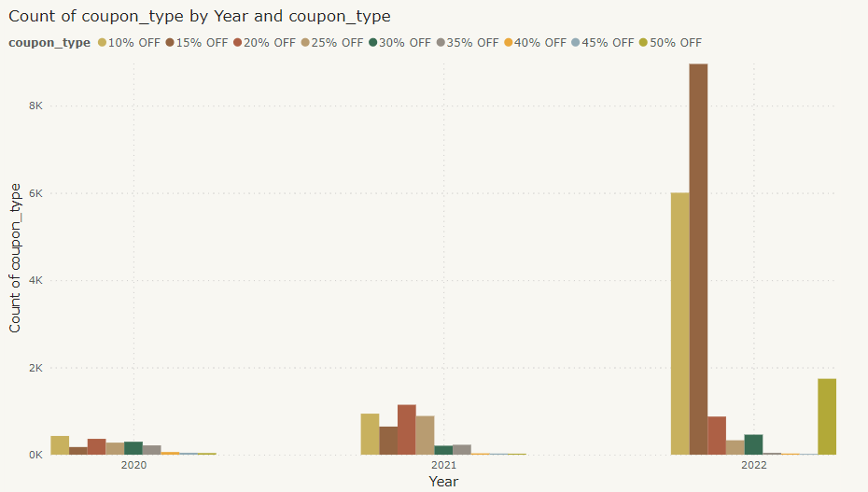
Do we need this slide??

